Slide 1
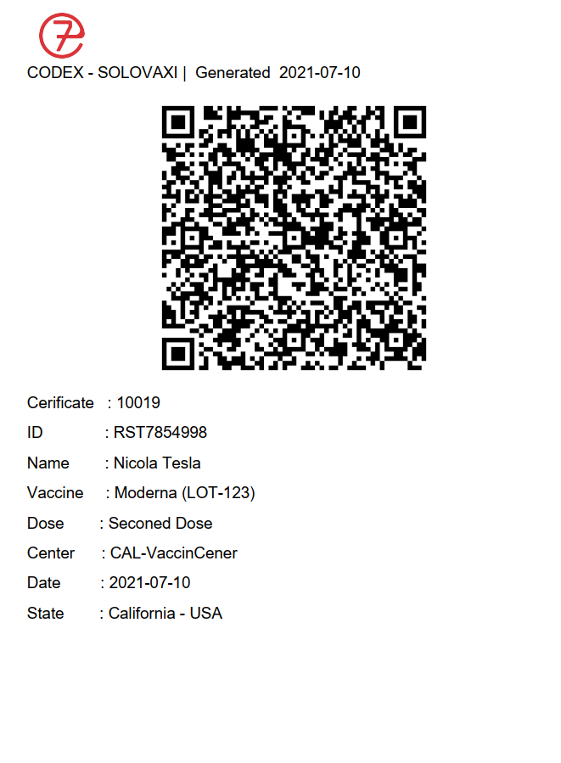
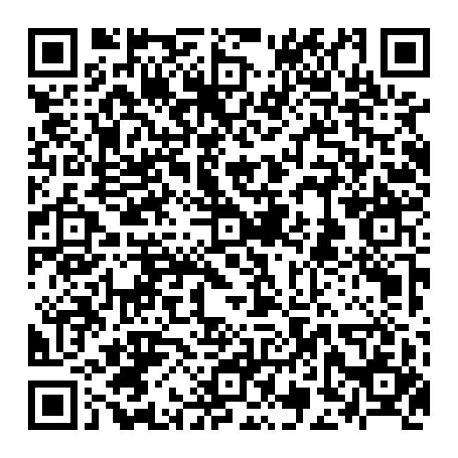
SOlOvaxi
Solovaxi is central portal for Record, Generate and verify covid-19 vaccination. Solovaxi generates QR and PDF human readable certificate
QR Contain certificate details

Slide 2
How Solovaxi works:
• Up on vaccination center, official id will be presented by person applying for vaccination with vaccination confirmation in same center the data of vaccine, vaccine center and vaccinated person will be updated to Solovaxi database by vaccine center with access permission.
• Every certificate recorded in Solovaxi has unique CID (Certificate ID).
• Solovaxi has its own central data base, accessible online with specific user permission allows instance verification of certificates ( as it planned).
• Vaccine certificate in QR form can be scanned for quick verification (QReader 1.7).
• Query about certificate using person’s Name, ID, Telephone and CID can be done.

Slide 3
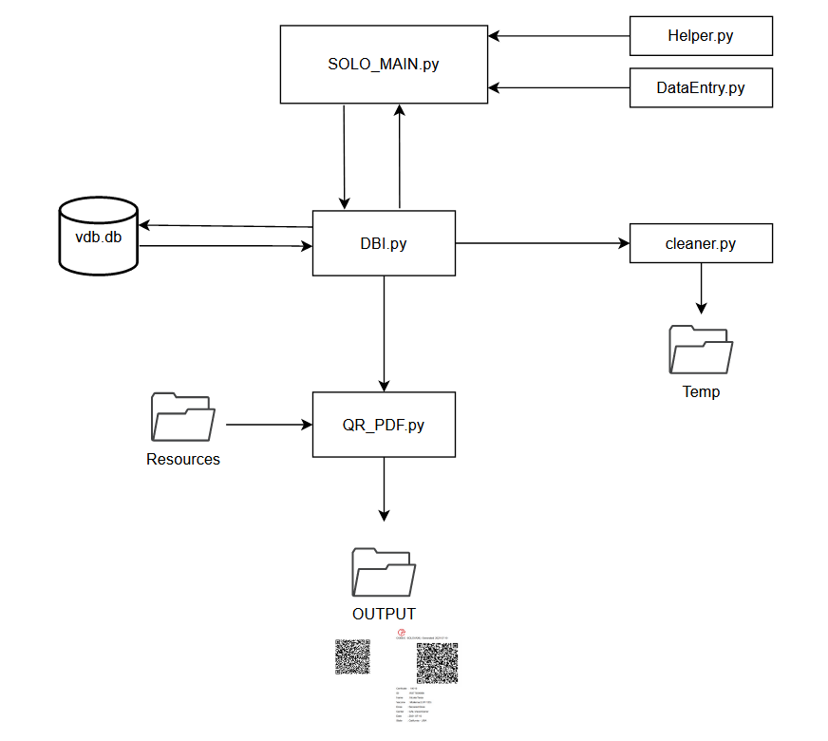
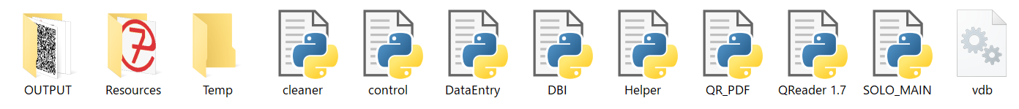
General Structure

Slide 4
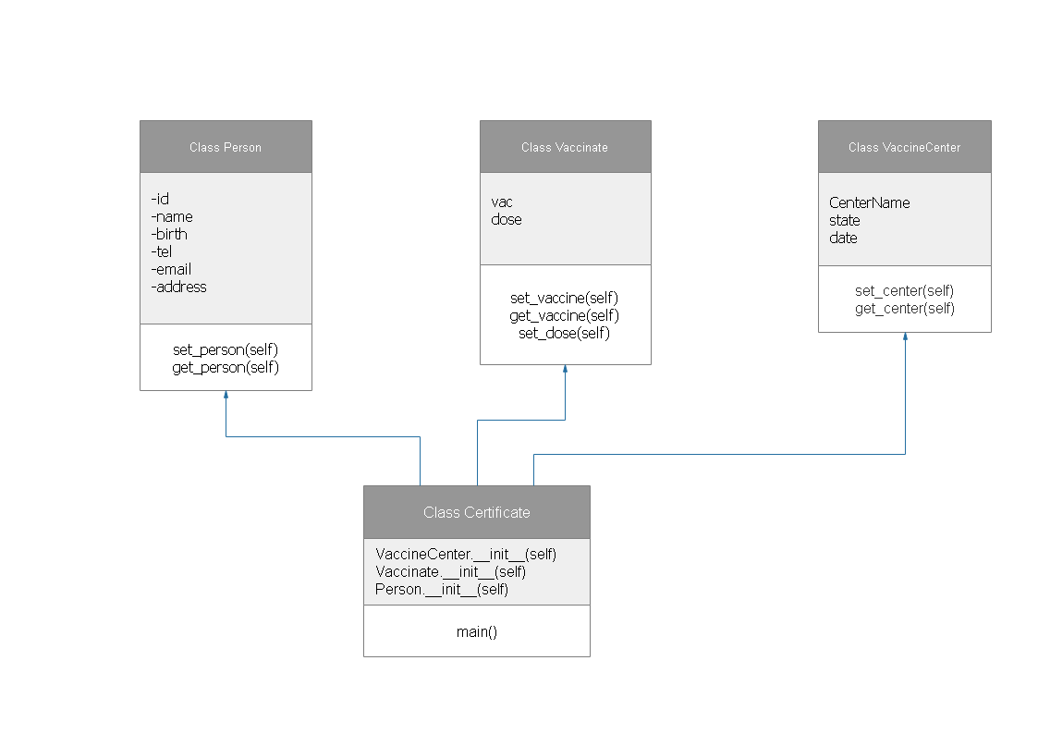
Class Structure (SOLO_MAIN)

Slide 5
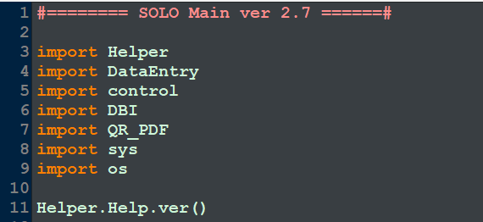

Slide 6
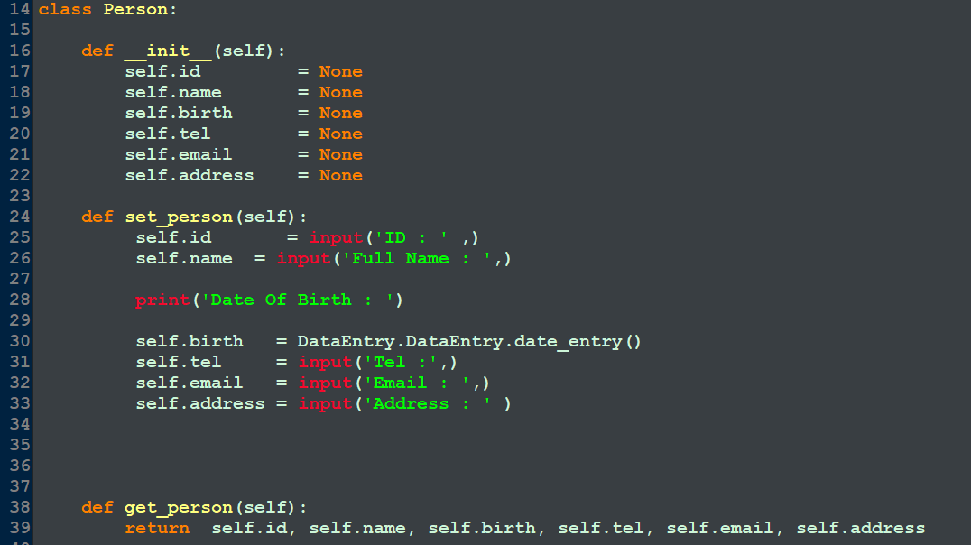

Slide 7
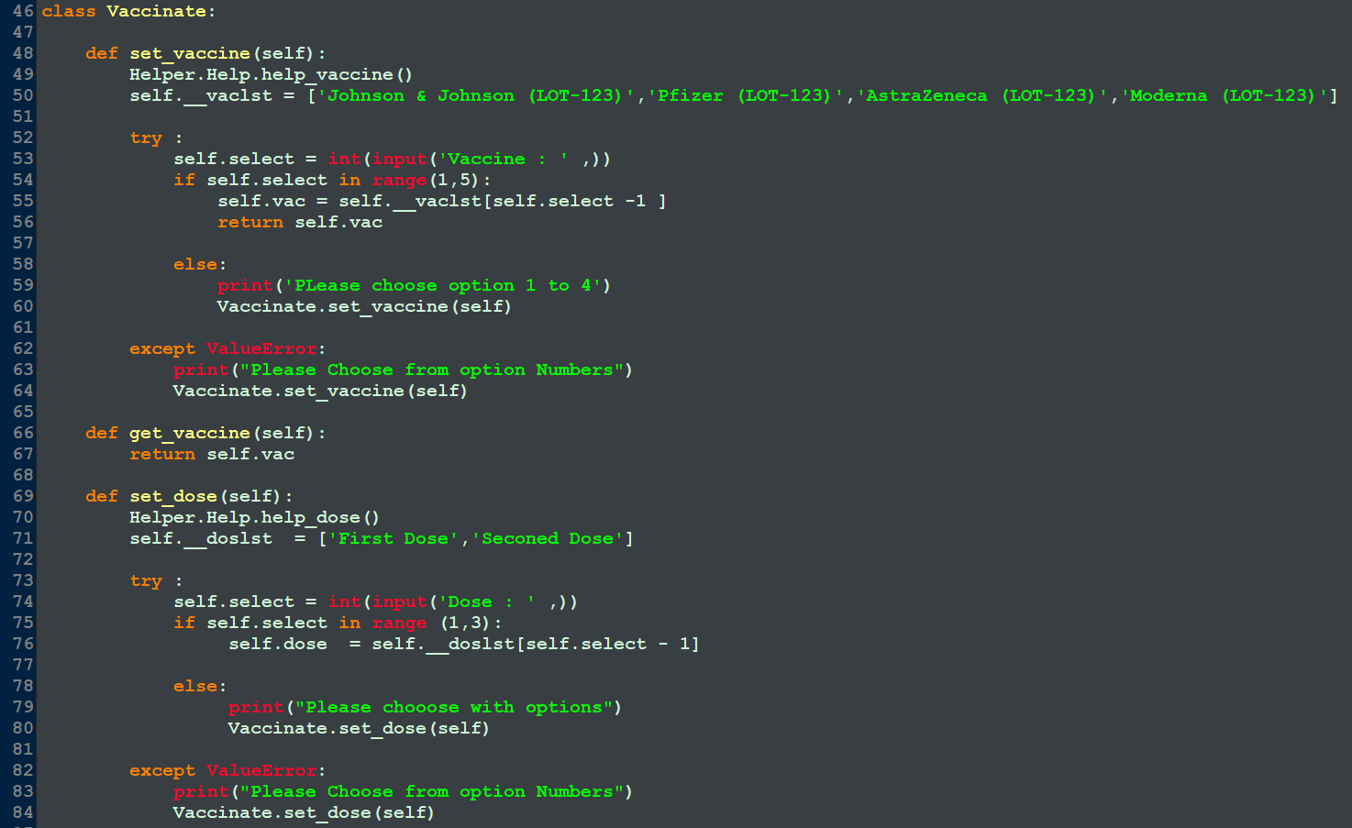

Slide 8
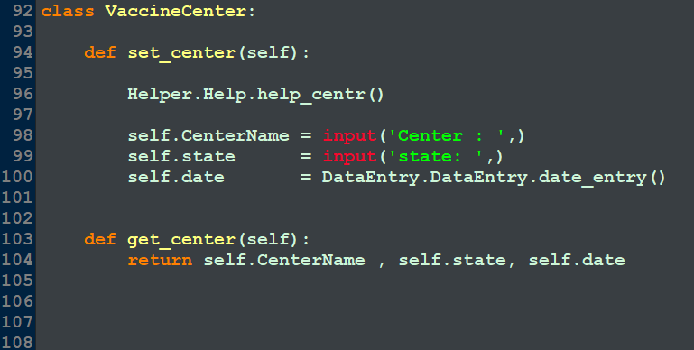

Slide 9
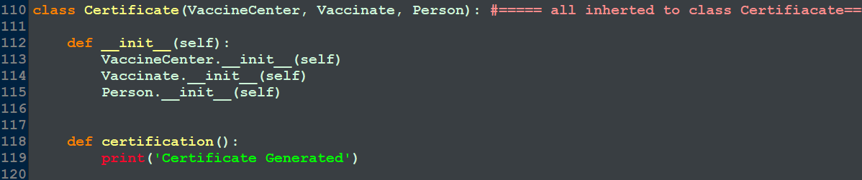

Slide 10
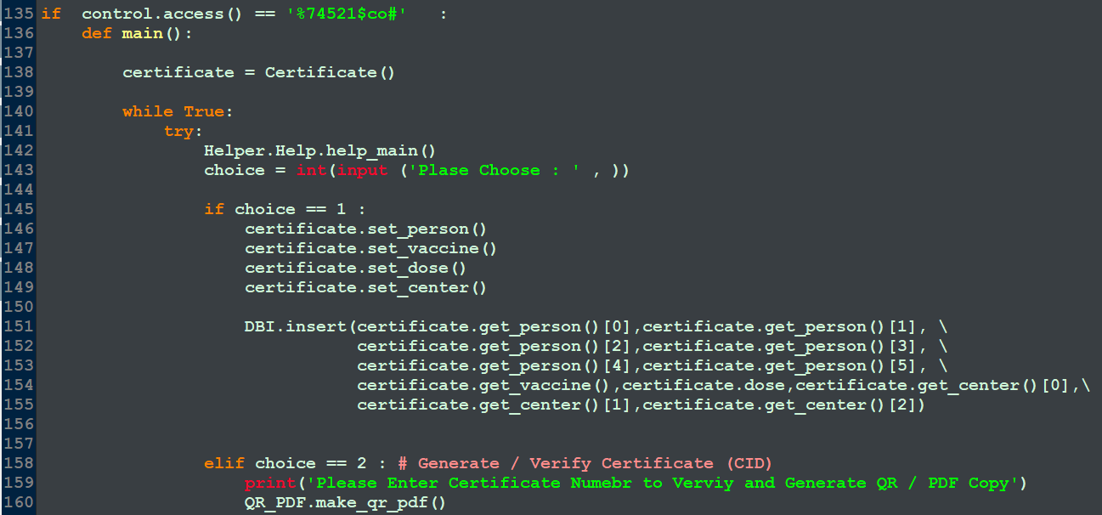

Slide 11
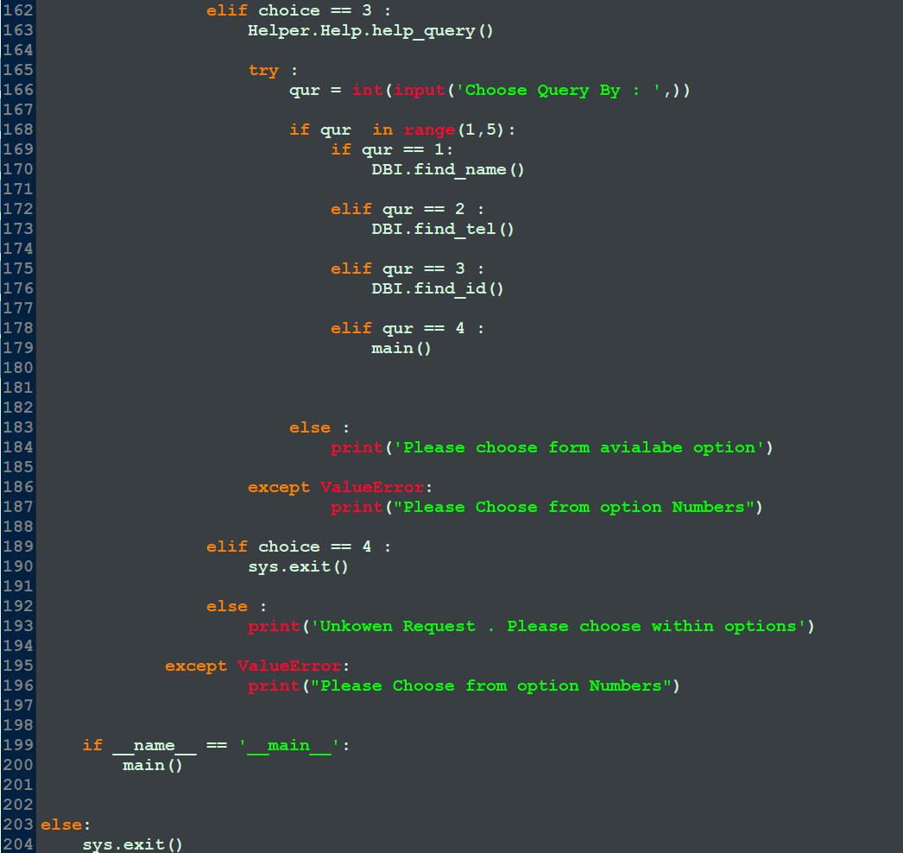

Slide 12

Live Demonstration

